Slide 1

Introduction to
Human Computer Interaction (HCI)
Chapter 1

Slide 2
What is HCI?
In the past, man-machine interaction (MMI)
HCI is the study of people & computing and the way they influence each other
Human + Computer + Interaction
Usability is the main concept in HCI
Usability is concerned with making systems safe, easy to learn and easy to use

Slide 3

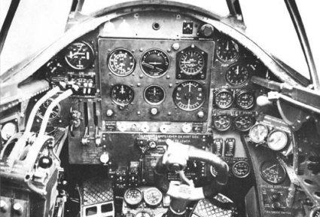

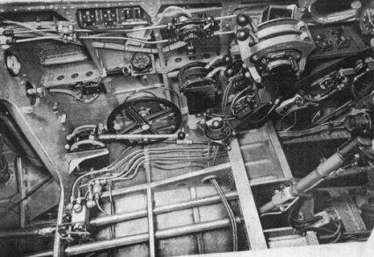
Cockpit WW II

Slide 4
The Goals of HCI
Increase individual & organizational productivity
Improve safety & Reduce health hazards
Reduce costs associated with the development of user interfaces

Slide 5
Computer
In the 1950/60s:
Computing resources were expensive
Computers operated by highly trained professionals

Slide 6
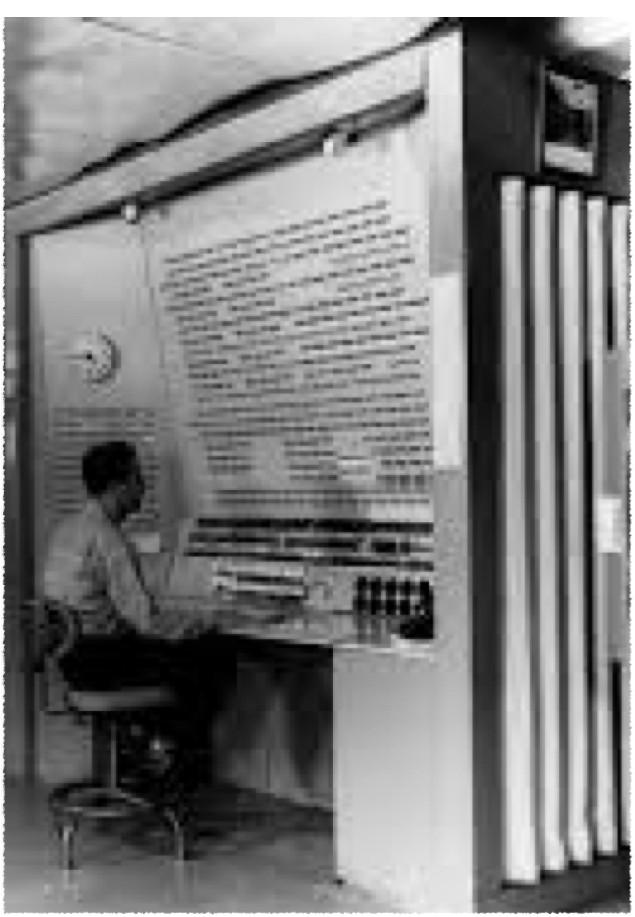
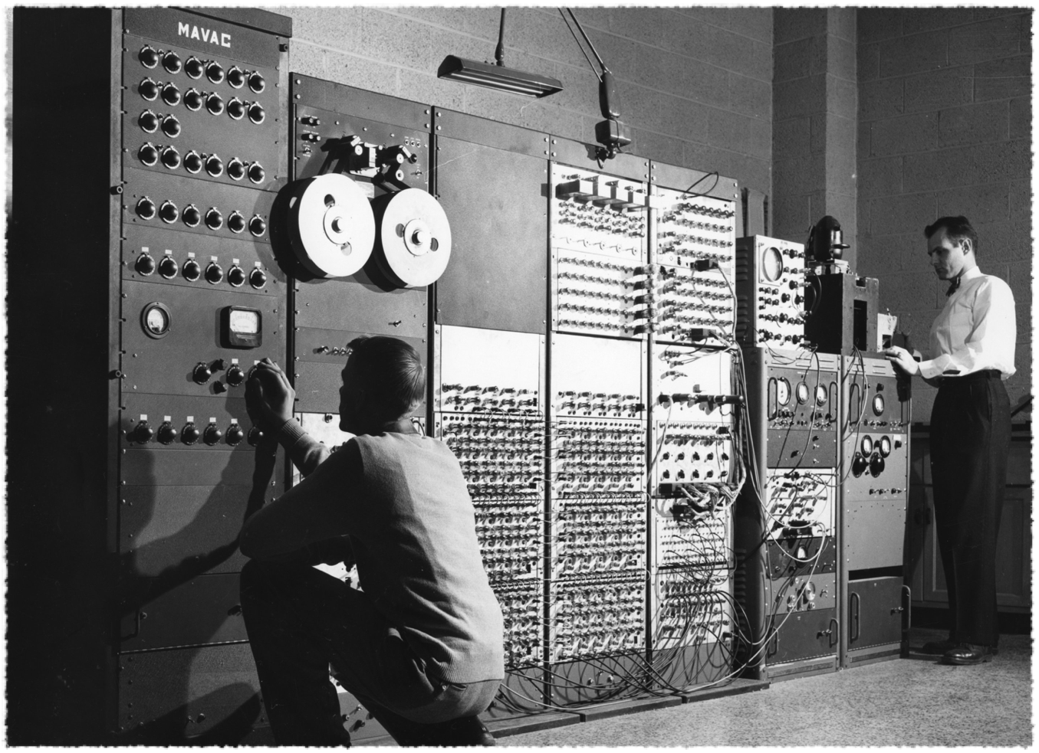
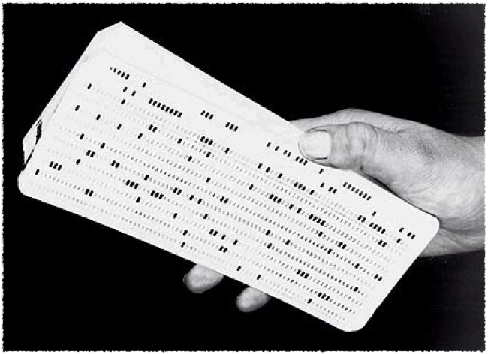

Slide 7

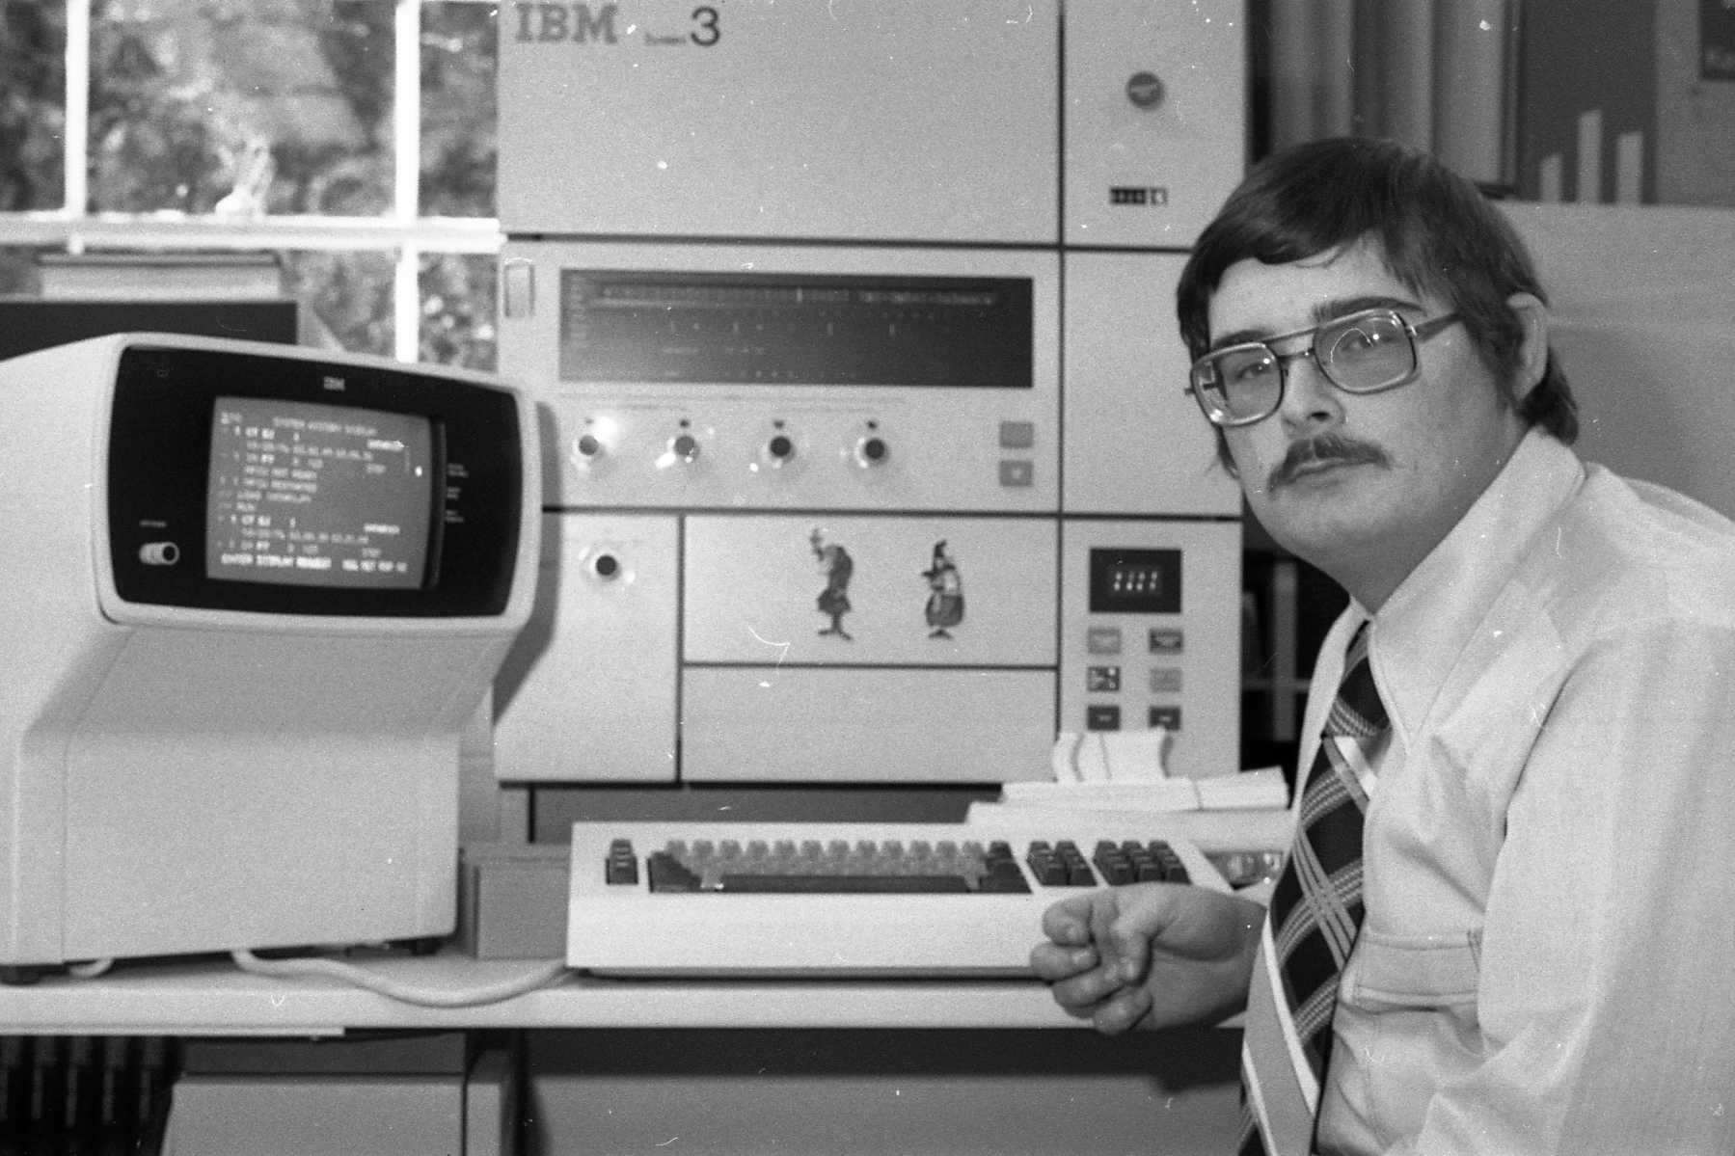

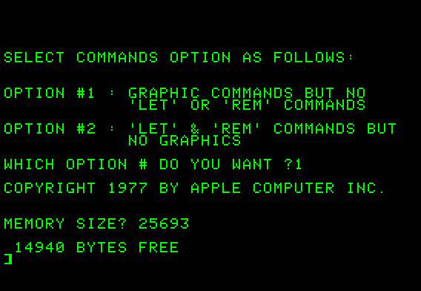
1970s: Personal computer & Command Line Interface (CLI)

Slide 8
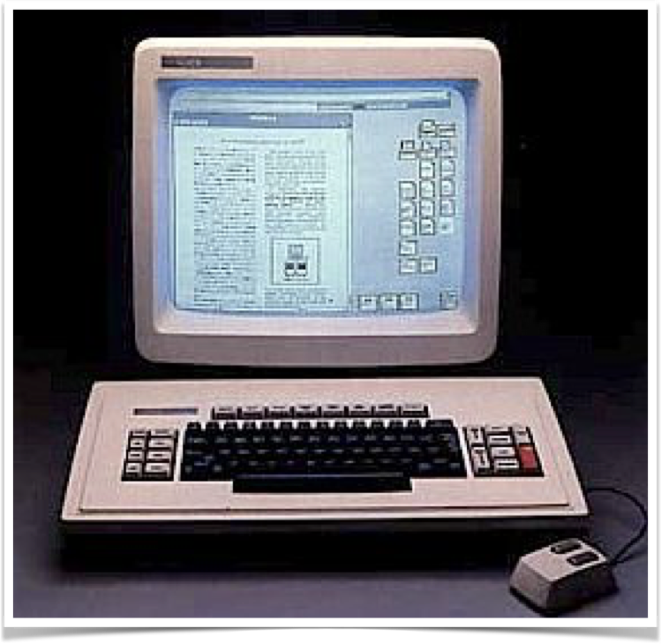
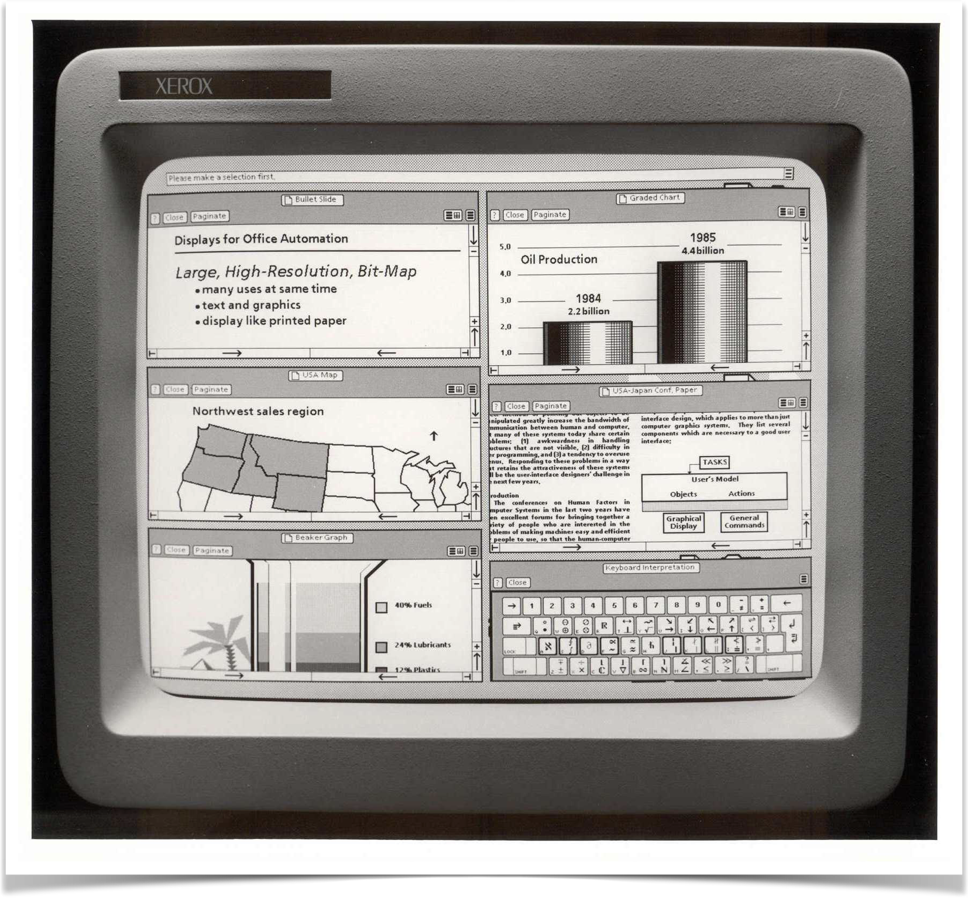
1980s: Graphical User Interface (GUI)
Xerox Star. The first commercial attempt at a mouse based GUI.

Slide 9
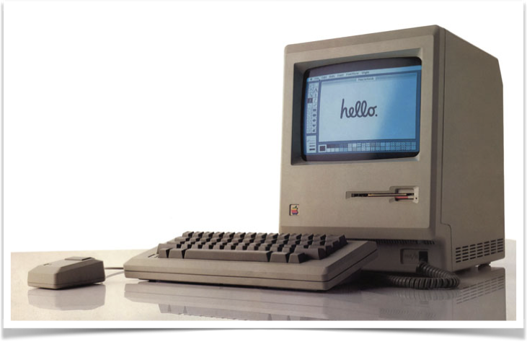
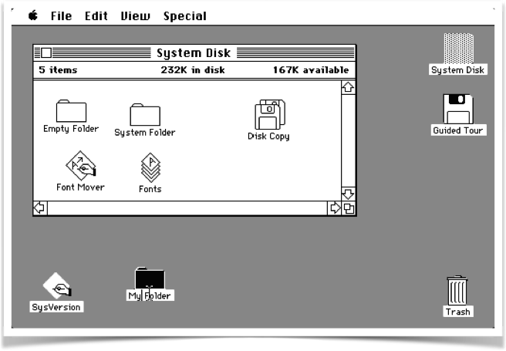
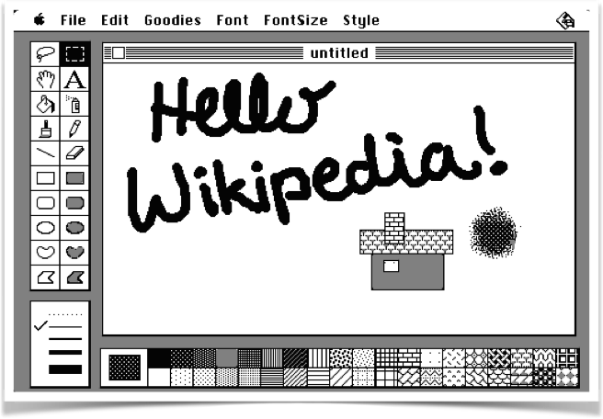
1984: Macintosh & GUI

Slide 10
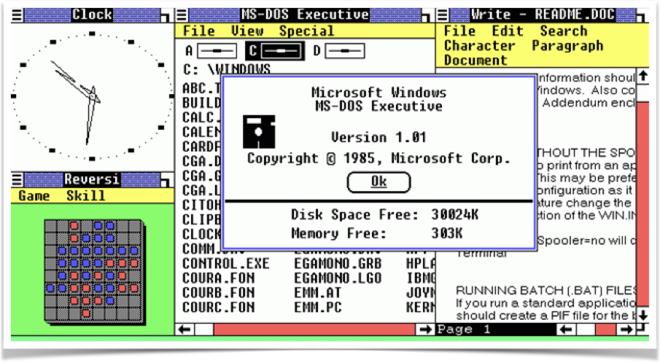
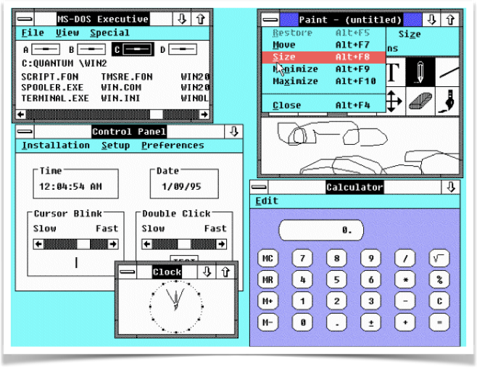
1987: Window 1.0 & 2.0

Slide 11

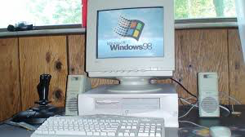

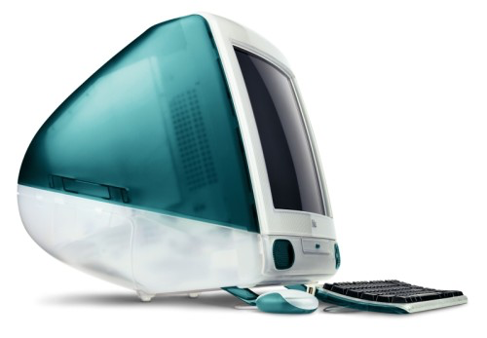
In the 1990/2000s
Computing resources are cheap
Computers are operated by non-computer experts

Slide 12
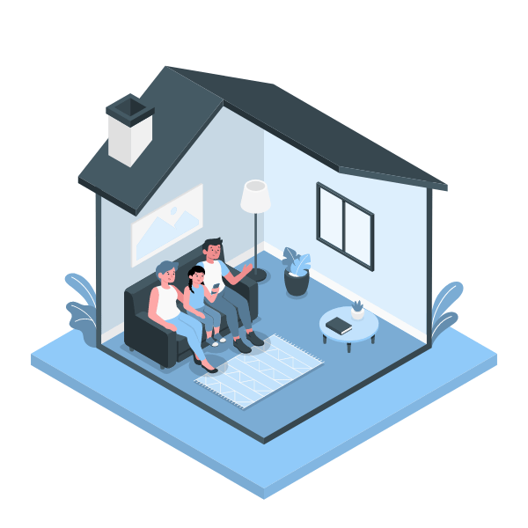
Present-future : Ubiquitous / Pervasive Computing

Slide 13
User Interface (UI)
It is the part of the product/system/software that user SEE, HEAR & TOUCH
Eg. in a STANDARD PC, the UI may consists of the following:
SCREEN, KEYBOARD, MOUSE, SPEAKERS
In other systems, the UI may consists of:
MICROPHONE (voice input)
BUTTONS (eg. ON/OFF and CANCEL on printers, remote controller, etc)
LIGHTS (modem, ATM, air-conditioner, etc)
HAND-TRACKING GLOVE which detects user fingers’ movements
EYE TRACKER that can trace where the user eyes are looking at

Slide 14
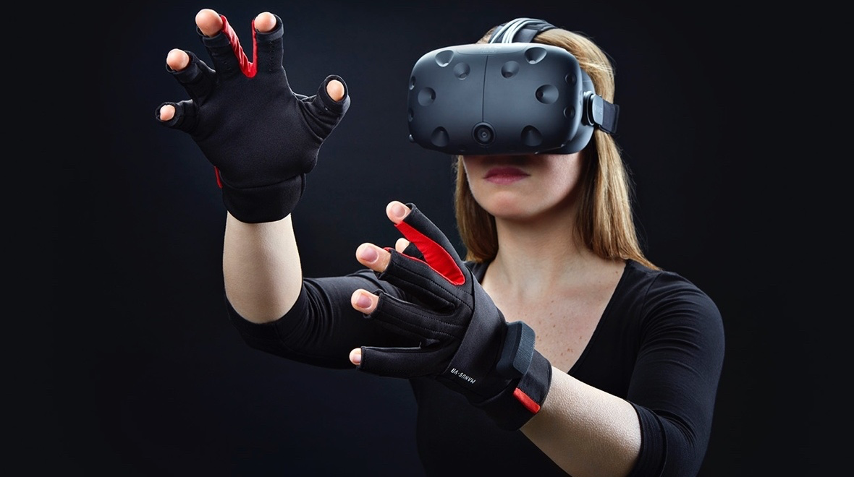
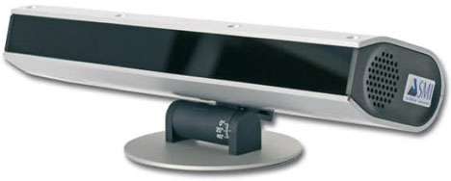
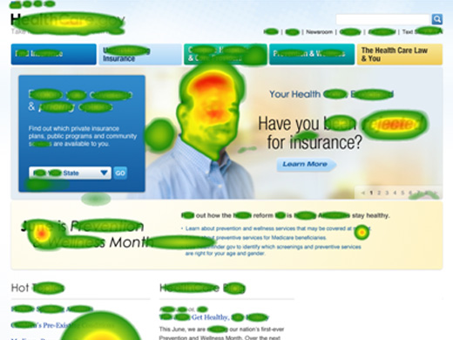
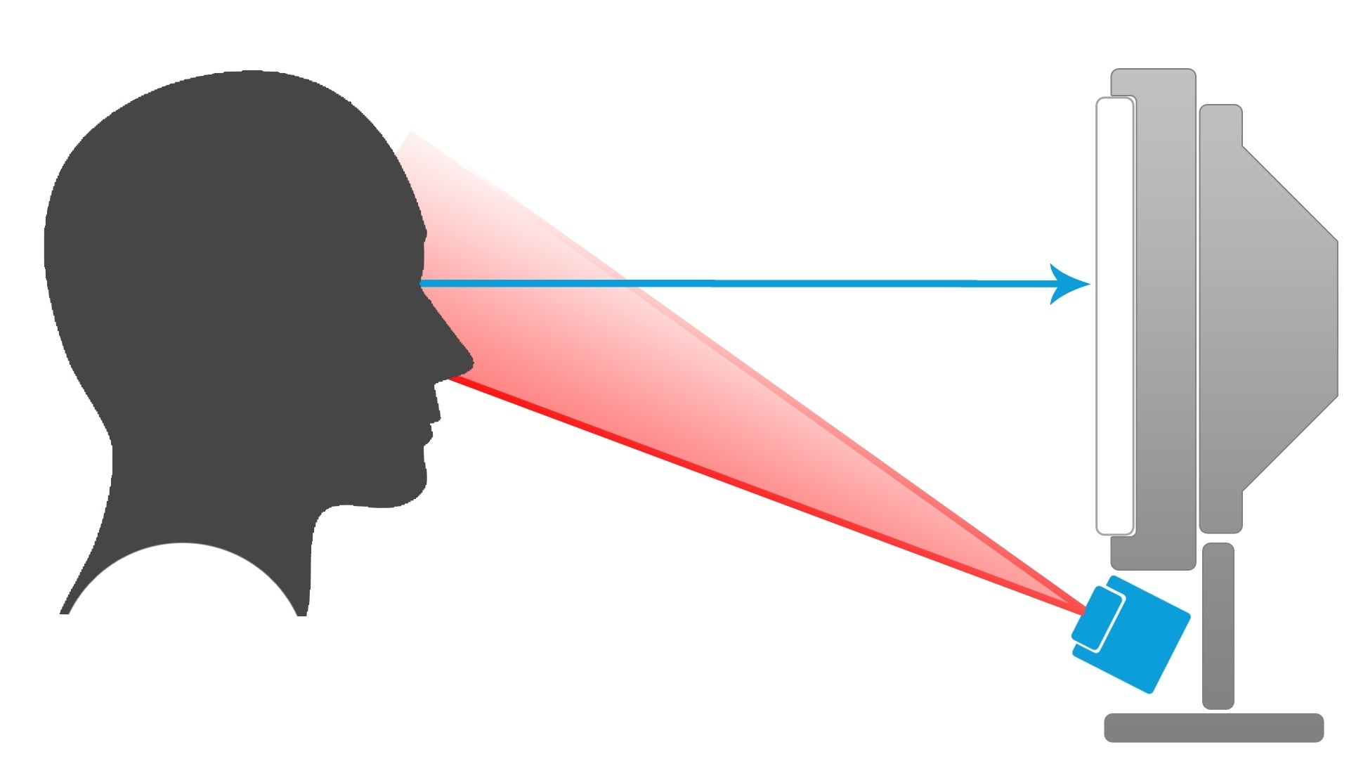
EYE TRACKER
HAND-TRACKING GLOVE

Slide 15

Human
The user (human) is the one whom computer systems are designed to assist. So , we need to know user (human) capabilities and limitations.
Humans are limited in their capacity to process information. This has important implications for design.
More details on coming chapter.

Slide 16

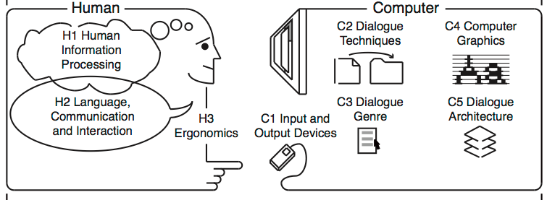
Interaction
Some keywords:
User Interface (UI)
Usability
User experience (UX)

Slide 17
Usability
Definition: The effectiveness, efficiency and satisfaction with which specified users achieve specified goals in particular environments (ISO 9241-11:2018)
Usability is a quality attribute that assesses how easy user interfaces are to use.
International Standard Organisation (ISO 9241-11:2018)
Effectiveness
Efficiency
Satisfaction

Slide 18
Benefits of systems/software/products with GOOD USABILITY
Benefits to the USERS
Increased productivity
Reduce learning time
Reduced errors
Reduced stress
Benefits to the DEVELOPERS
Minimize the cost of customer support
Reduce the time needed for training
Good reputation

Slide 19
Effectiveness
Effectiveness is the completeness and accuracy with which users achieve specified goals.
It is determined by looking at whether the user’s goals were met successfully and whether all works are correct.
Measurement of how well the system performs (desired output = actual output).
“Can users use the system to do the work they need to do?”

Slide 20
Efficiency
Efficiency is the resources used in relation to the results achieved. (Typical resources include time, human effort, costs and materials.)
Efficiency concerned primarily with how quickly a task can be completed,while effectiveness considers how well the work is done.
“Can experience users be productive using the system?”
“Once users have learned the design, how quickly can they perform tasks?”

Slide 21
Satisfaction
Satisfaction is the user's physical, cognitive and emotional responses that result from the use of a system, product or service meet the user’s needs and expectations
The comfort and acceptability of the work system to its users and other people affected by its use.
How pleasant is it to use the design?

Slide 22
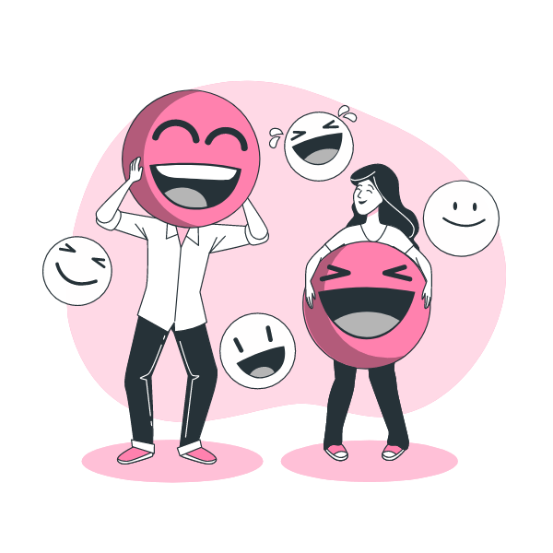
User Experience (UX)
Person's perceptions and responses resulting from the use and/or anticipated use of a product, system or service. (ISO 9241-210:2010)
Motivating
Aesthetic
Rewarding
Emotionally fulfilling
Informative
…..etc…
Enjoyable
Fun
Entertaining
Helpful

Slide 23
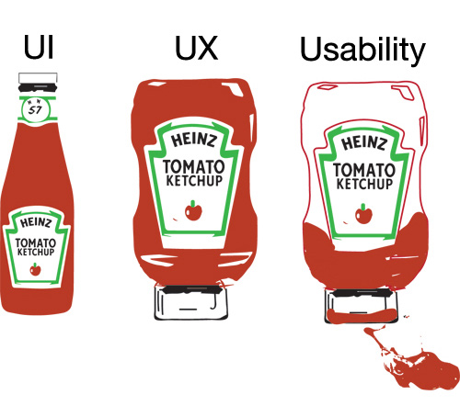

Slide 24
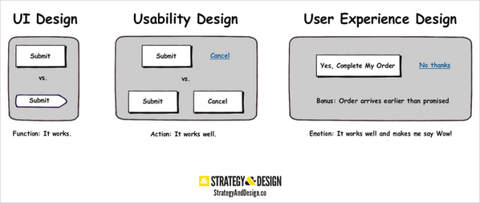

Slide 26

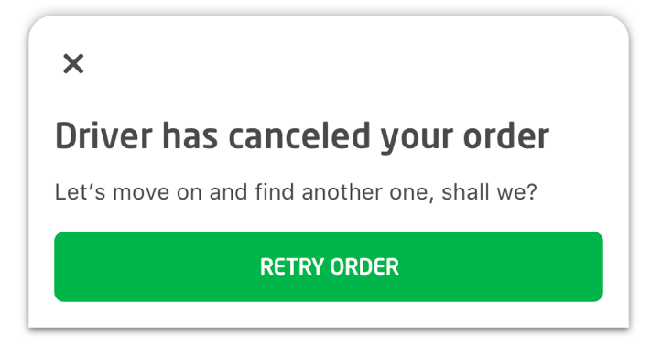
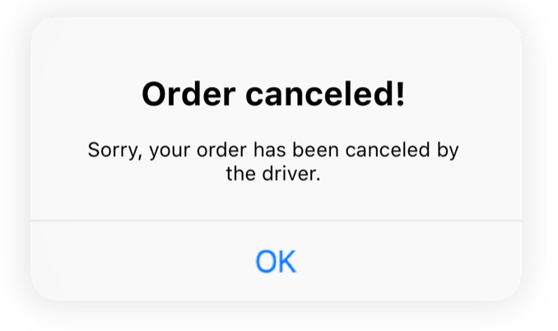
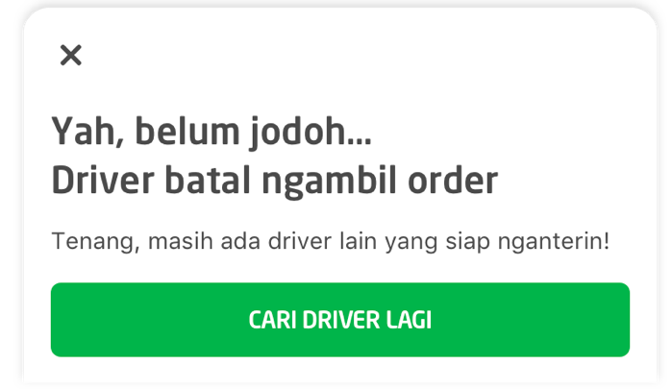
https://medium.com/life-at-go-jek/design-with-love-the-creative-process-behind-go-jek-redesign-d0e2338e7f7a

Slide 27
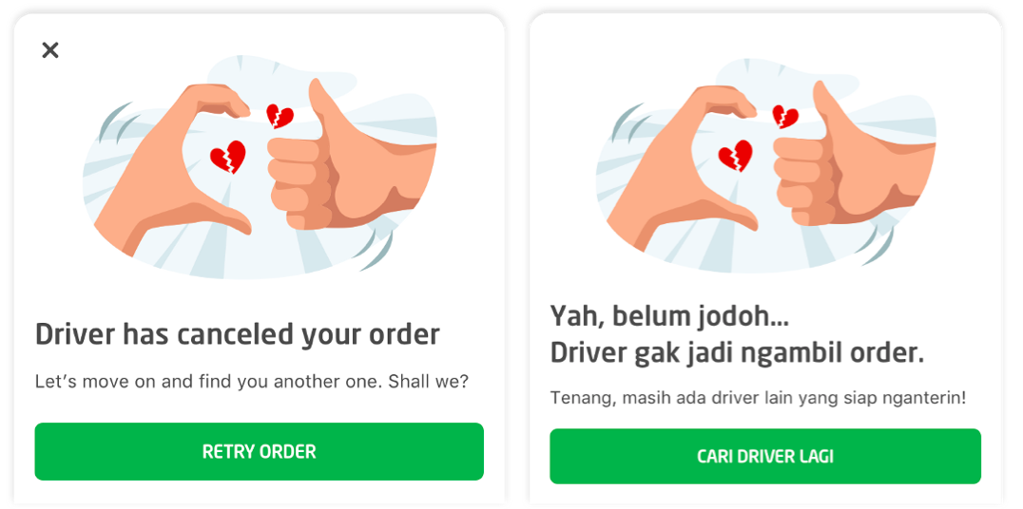

Slide 28

Usability + UX

Slide 29
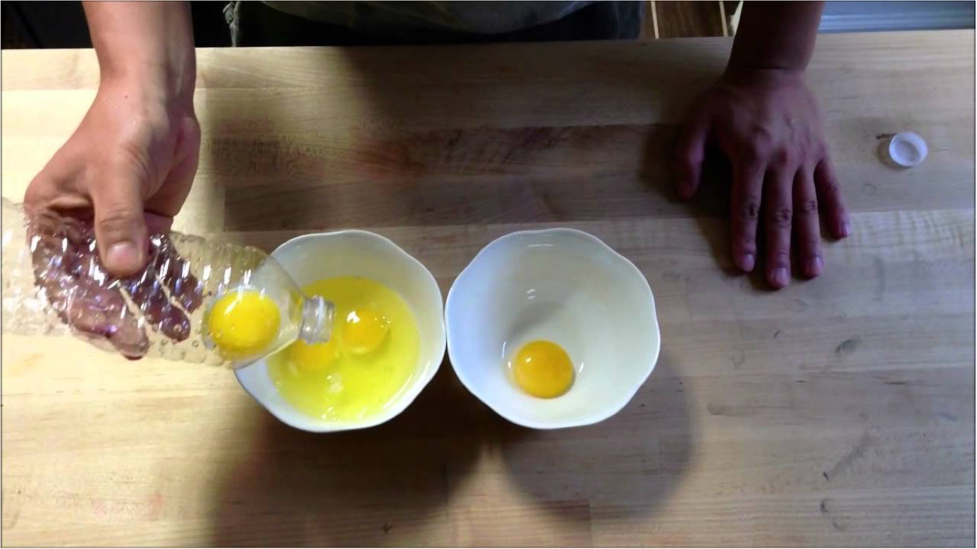
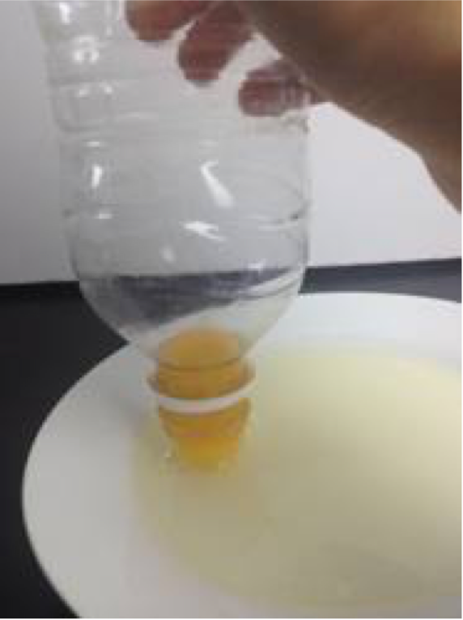

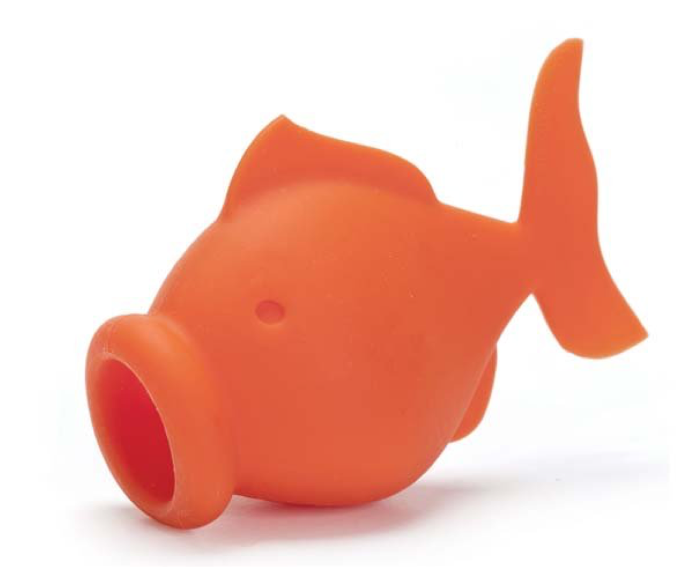

Slide 30
Effect of poor UI design/ Usability Problem
It is sometimes difficult to see/notice the effects of good design, but there are many examples of the EFFECTS OF POOR UI DESIGN
THE EFFECTS can…
cause user to makes more errors
cause unnecessary anxiety and inconvenience to the user
Decrease user productivity
makes the product difficult to use and learn
Cause the product to be perceived to have low quality and value

Slide 31
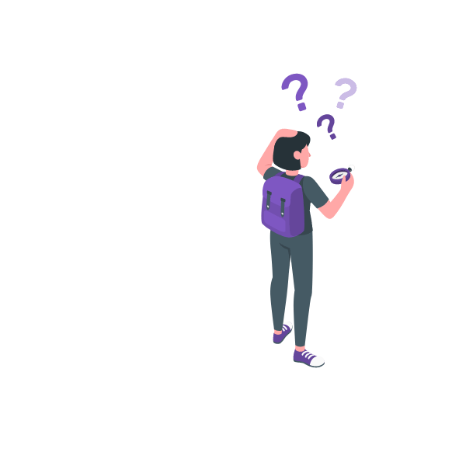
How to design a good UI with good usability?

Slide 32
This course will teach you how to DESIGN, CONSTRUCT & TEST user interfaces (UI)
The goal is to provide you with the needed knowledge to design a good UI for a product/system/software
Generally, people like systems/applications that are easy to use
A system/software/product that is easy to use, have HIGH level of USABILITY
Others which gives user a nightmare, have LOW level of USABILITY

Slide 33
Disciplines Contributing to HCI
Computer Science
- the study of construction of software.
- Provide knowledge about the capabilities and limitations of the technology.
Cognitive Psychology
- the study of how info is processed and represented in the mind.
- Provide knowledge about the capabilities and limitations of the users.

Slide 34
Ergonomics/human factors
- the study of human beings in relationship to their working environment
- Provide knowledge about how to design tools to suit the capacities and capabilities of the users
- Also provide knowledge about how to design the working environment to suit the users rather than the other way round.
Social and Organizational Psychology & Others…………..
The ideal designer of interactive systems should have expertise in a variety of disciplines
(in other words an interactive system designer should have a wide variety of knowledge)

Slide 35
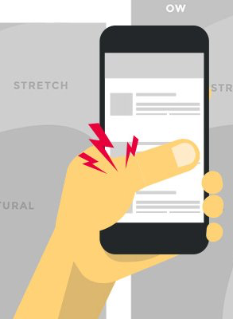
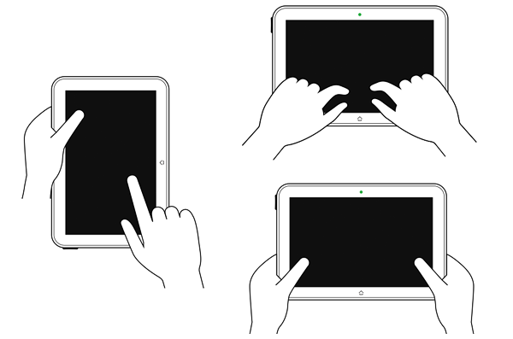
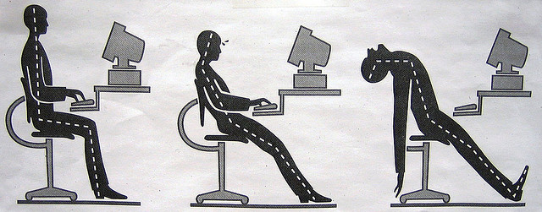
Ergonomics/human factors

Slide 36

D
A
B
Computer Science
Cognitive Psychology
Ergonomics/human factors
Social and Organizational Psychology
C

Slide 37
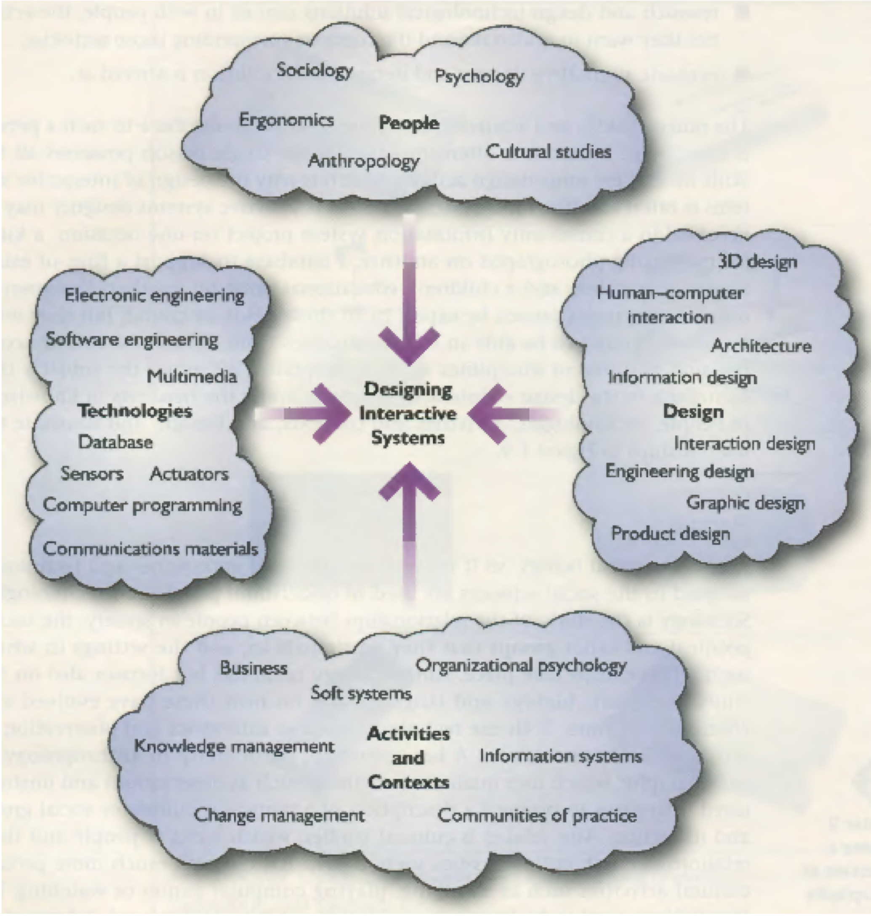
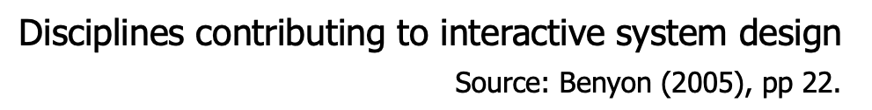

Slide 38

“It is not possible to design effective interactive systems from one discipline in isolation”— Alan Dix
Input is needed from other disciplines because we need to understand:
the COMPUTER SYSTEM
the USER and the TASKS the user is performing
the ENVIRONMENT in which the task is being perform

Slide 39
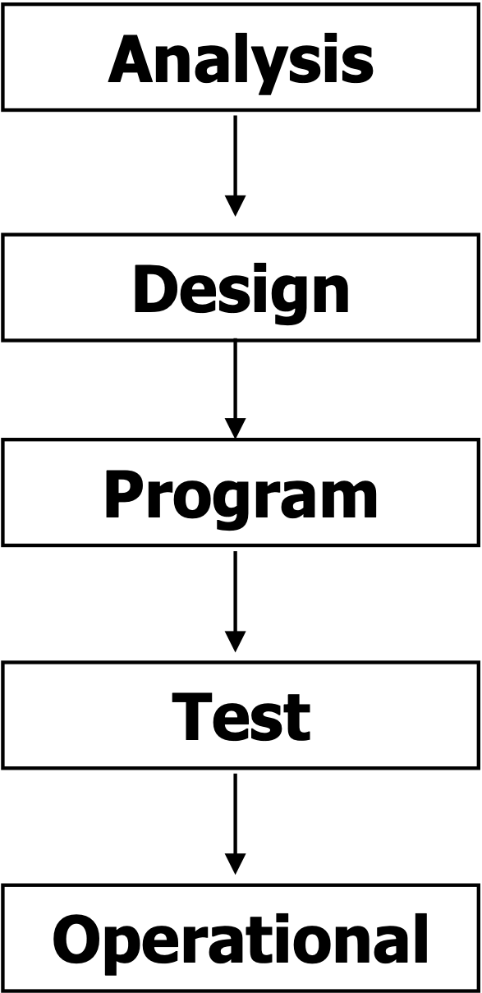
HCI and Software Development
The Development process (Traditional way)
Follows numbers of stages in sequence
At the beginning, the requirements for the system are analyzed and then this information is processed and converted into a design, which is then coded and tested and the product is completed and becomes operational.
This approach to software development is called the “WATERFALL” lifecycle model of software development

Slide 40
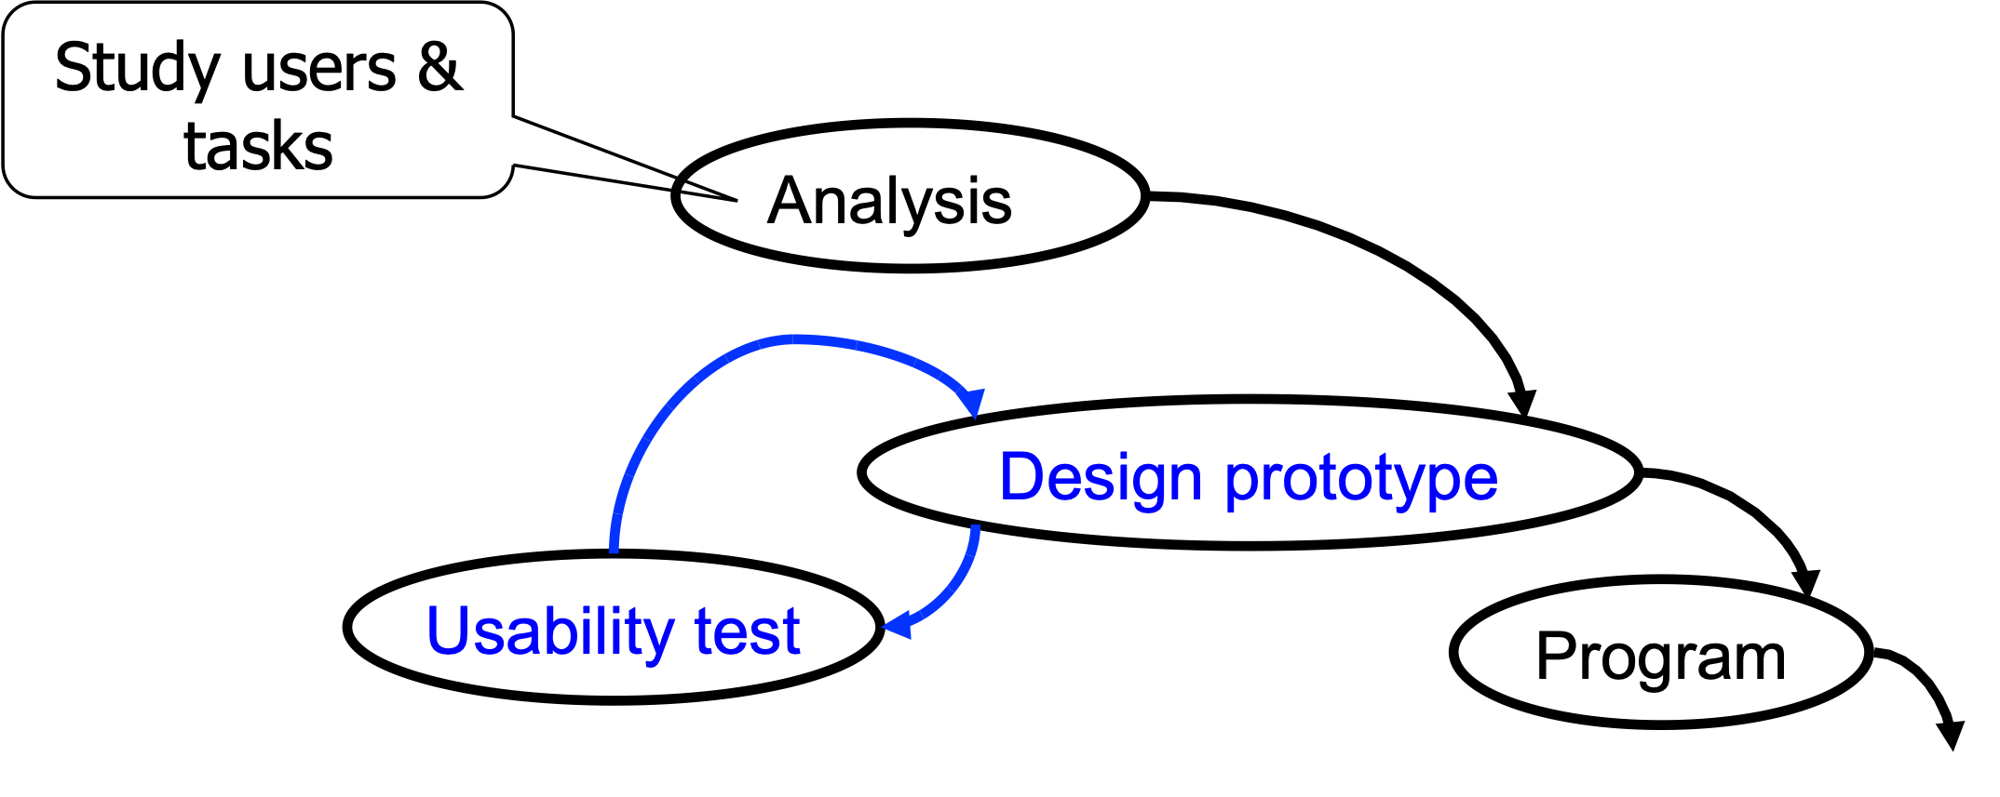
The development process _HCI framework
So, to make a good UI:
focus on users and their tasks (be user centered)
build a little(prototype), test a little (usability test)
iterate until a good design is achieved

Slide 41
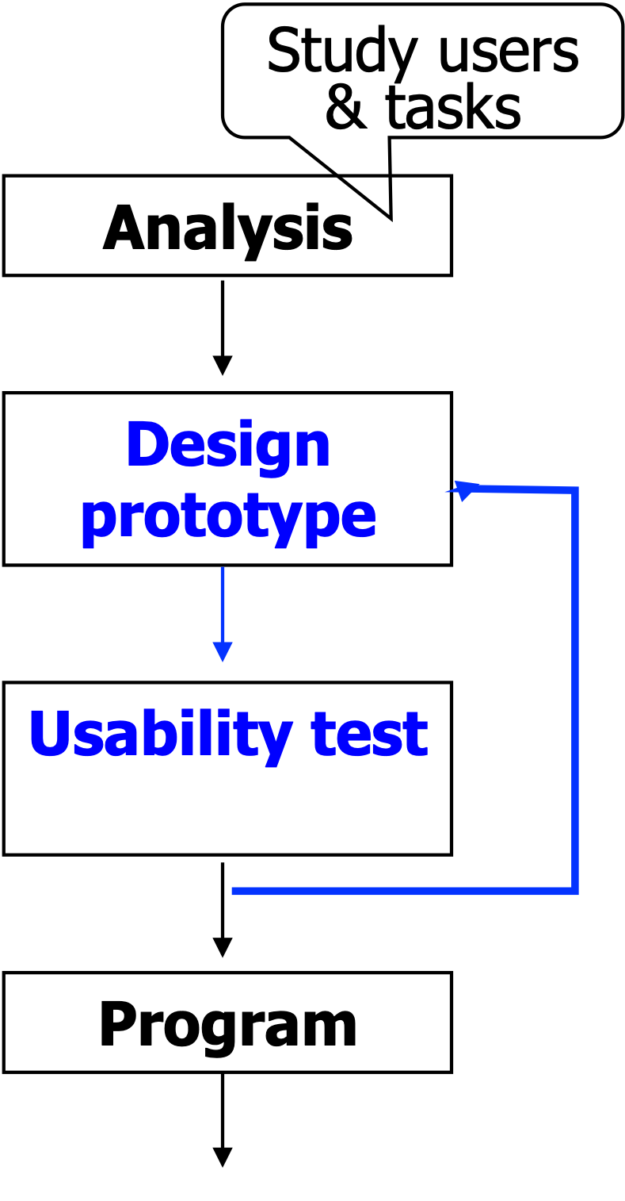
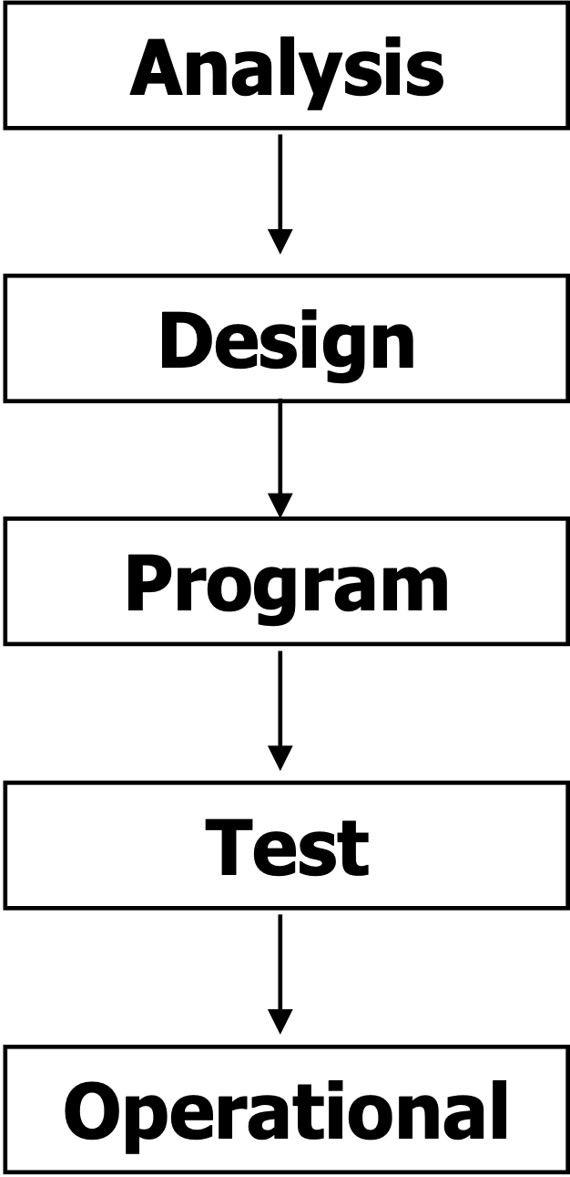
The essential difference between the waterfall approach and the HCI Framework : Iteration

Slide 42
Waterfall Approach
Development process often driven by functional processing requirements
deliver what the designer think what the users want
HCI Framework
Focus on user’s need
Analyse user’s tasks so can provide functionality to support those tasks
Build prototype
Carry out early testing & evaluation with users
Iterate until a good design is achieved

Slide 43
People, Activities, Contexts, Technologies (PACT) Analysis
Before we even begin an UI design, we must first identify and understand current situation, and assess if any possible improvements can be made.
PACT analysis looks at:
People: Sociology, culture, biology, language, psychology, etc…
Activity & Context: Interaction that take place in the context of some ‘community of practice’. Eg. Business community and its organisation of information.
Technologies: Selecting appropriate software and hardware.

Slide 44
Designing a train ticket machine.
People: physical (age,height, weight), psychology(memory, mental models), usage (expert, novices)
Activities: time (when, frequency), complexity, safety critical, content( information/media dealing with)
Context: physical environment, social context (culture/language).
Technology: input (touch screen,mouse) , output (monitor, speaker)

Slide 45
Thank you

